Slide 1
PRESENTED BY
NAME : ANLIN JERISHA J K
REGISTER NO : 962821205007
DEPARTMENT : INFORMATION TECHNOLOGY
Image Classification Using CNN
3/21/2024 Annual Review

Slide 2
PROJECT TITLE
Image Classification Using CNN
3/21/2024 Annual Review

Slide 3


AGENDA
Problem Statement
Problem Overview
Solution and Value Proposition
The Wow Solution
Modelling
Results
3/21/2024 Annual Review
3

Slide 4

PROBLEM STATEMENT
In this project we build a system that can automatically identify objects from the CIFAR-10 dataset.
This dataset contains thousands of images across different categories, such as cars, airplanes, and animals.
The problem statement is to develop a computer program capable of accurately recognizing and categorizing these object within the images.
3/21/2024
4

Slide 5

PROJECT OVERVIEW
The main objective of this project is to develop a robust image classification system using Convolutional Neural Networks (CNNs) to accurately categorize images into predefined classes using CIFAR-10 dataset.
Our goal is to train a model to accurately identify the objects present in dataset images.
3/21/2024 Annual Review

Slide 6

WHO ARE THE END USERS?
Research Institutions and Academia
Tech Companies
E-commerce Platforms
Social Media Platforms
Healthcare Industry
Security and Surveillance
3/21/2024 Annual Review

Slide 7

SOLUTION AND ITS VALUE PROPOSITION
The CNN model offers high accuracy in image classification, ensuring reliable performance across diverse datasets and applications.
The automated image classification process reduces manual effort and accelerates decision-making in tasks requiring image analysis and categorization.
The deployment-ready solution enables seamless integration into production environments, streamlining workflows and enhancing operational efficiency.
3/21/2024 Annual Review

Slide 8

THE WOW IN YOUR SOLUTION
Custom-designed CNN architecture optimized for the CIFAR-10 dataset, incorporating convolutional layers, pooling layers, and fully connected layers to extract intricate features and patterns from images.
Intuitive and interactive user interface providing easy access to model functionalities, visualization tools, and performance metrics, catering to users ranging from developers and researchers to businesses and enthusiasts.
3/21/2024 Annual Review
8

Slide 9
MODELLING
The modelling phase involves designing, compiling, training, and evaluating a CNN architecture tailored to the CIFAR-10 dataset.
It can develop a high-performing image classification model capable of accurately categorizing images from the CIFAR-10 dataset into one of ten predefined classes.
Continuous experimentation, evaluation, and optimization are key to achieving optimal results and advancing the state-of-the-art in image classification using CNNs.
3/21/2024 An ual Review
n

Slide 10
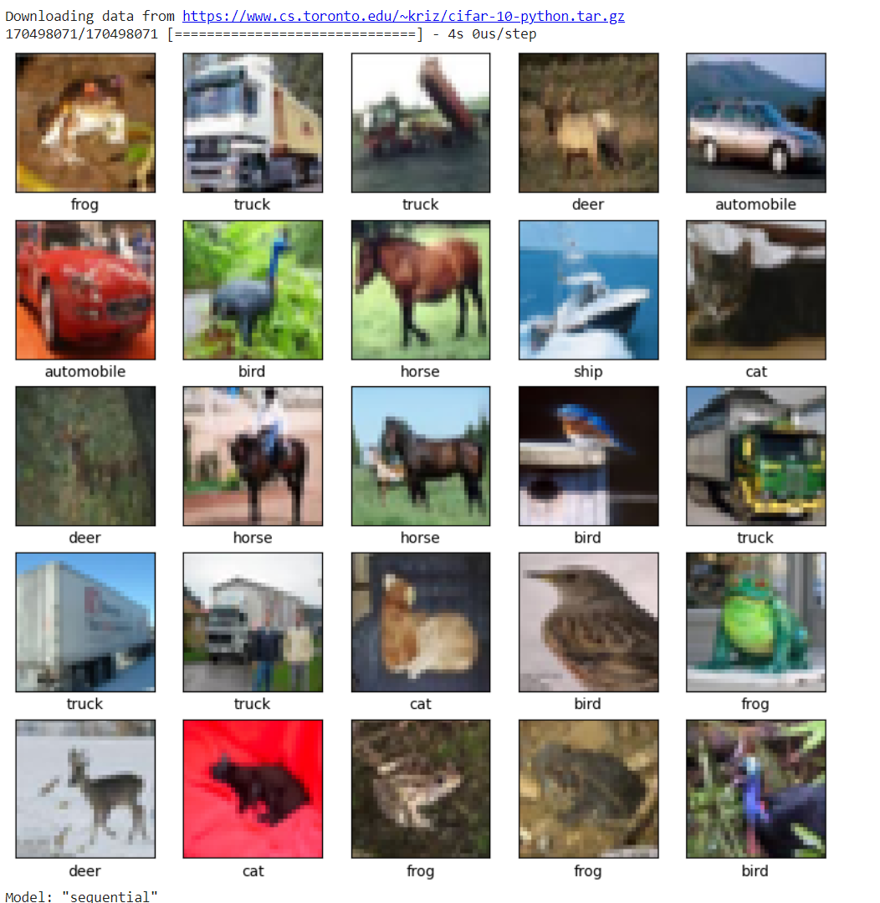
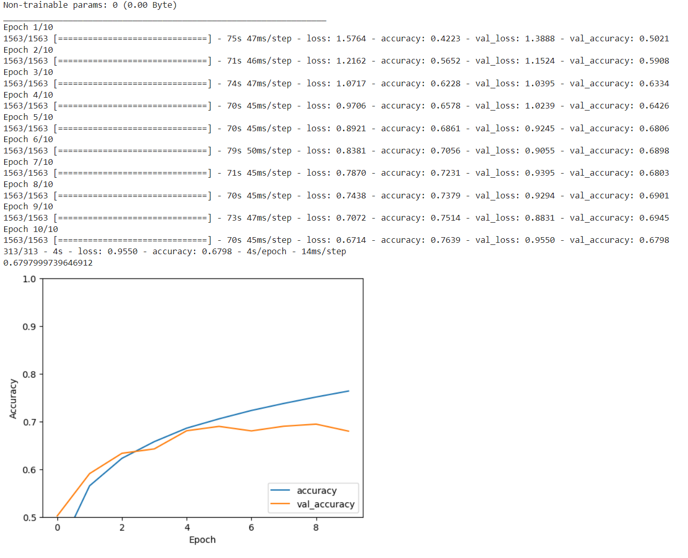
RESULTS
n

Slide 11
CONCLUSION
This project highlights the effectiveness of deep learning in computer vision tasks and underscores the potential of CNNs in solving complex image classification challenges.
Achieved high accuracy and robust performance in categorizing images into ten classes.
Demonstrated the effectiveness of deep learning in computer vision tasks.
Laid a foundation for future innovations and applications in AI-driven technologies.

